Slide 1

A Mini Project Review on
“CHARON A SECURE CLOUD OF CLOUDS SYSTEM FOR STORING AND SHARING BIG DATA”
Submitted by
B. SAHITH, H.T.No: 20N61A562
MD. ASHFAQ, H.T.No: 20N61A583
G.CHAKRANK, H.T.No: 20N61A574
SYED AQEEL, H.T.No: 20N61A581
Under the Guidance of
Dr. D. Murali, Professor & Principal
DEPARTMENT OF COMPUTER SCIENCE AND ENGINEERING
VIVEKANANDA INSTITUTE OF TECHNOLOGY & SCIENCE

Slide 2
ABSTRACT:
CHARON is a secure and efficient cloud storage system for big data, ensuring reliability across multiple cloud providers. It stands out with its trustless architecture, absence of client-managed servers, and effective handling of large files across distributed storage services. A novel Byzantine-resilient leasing protocol prevents conflicts in shared repositories. Evaluation with bioinformatics benchmarks demonstrates CHARON's feasibility and up to 2.5 times better end-to-end performance compared to alternative cloud-backed solutions.

Slide 3
EXISTING SYSTEM:
Consensus Protocol Efficiency:
Byzantine disk Paxos and its file synchronization service version offer mutual exclusion but demand
more cloud accesses. In contrast, CHARON's lease protocol requires only two to four cloud
accesses for acquiring a lease, ensuring efficiency.
Fault-Tolerant Lease Algorithms: Only two fault-tolerant data-centric lease algorithms exist in literature. CHARON's BFT composite lease outshines Chockler and Malkhi's by providing an always-safe lease and not relying on individual cloud provider trust. DepSky's mutual exclusion algorithm, though a candidate, is 4-10 times slower than CHARON's composite lease, doesn't require synchronized clocks, and avoids weakly-consistent operations.

Slide 4
Hybrid Cloud Storage Systems: Systems like Hybris , SCFS , and RockFS use a hybrid approach, combining unmodified cloud storage services with a few computing nodes for metadata and coordination. However, they require servers in cloud providers, incurring additional costs and management complexity. This limitation extends to modern geo-replicated storage systems like Spanner, SPANStore, and Pileus when deployed in multiple clouds.
Aggregation of File Synchronization Services:
Some works propose aggregating file synchronization services (e.g., DropBox, Box, Google Drive)
into a single service . CYRUS lacks concurrency control, allowing different clients to create
conflicting file versions concurrently.

Slide 5
DISADVANTAGES OF EXISITING SYSTEM:
In the existing work, system is less effective while dealing with shared files.
The system has less security while working with data chunks.

Slide 6
PROPOSED SYSTEM:
CHARON is a user-friendly distributed file system designed for non-experts in life sciences. It provides a POSIX interface for seamless access to multiple cloud services, efficient handling of large files, and controlled file sharing without server deployment or modifying existing cloud services.
CHARON optimizes file transfers by absorbing local disk writes, asynchronously uploading to cloud storage. It accelerates reads through prefetching and parallel downloads. To enhance usability, it avoids write-write conflicts, eliminating reliance on user/application conflict resolution
The decision is justified by file size and user characteristics. Manual conflict resolution in large files is cumbersome. Non-expert users may struggle with conflict repair. Maintaining duplicates incurs significant costs, crucial for collaborative repositories like Google Genomics, where users analyze and share derived data.

Slide 7
ADVANTAGES OF PROPOSED SYSTEM:
Mutual Exclusion (safety): There are never two correct clients with a valid lease for the same resource.
Obstruction-freedom (liveness): A correct client that tries to lease a resource without contention will succeed.
Time-boundedness (liveness): A correct client that acquires a lease will hold it for at most T time units unless the lease was renewed

Slide 8
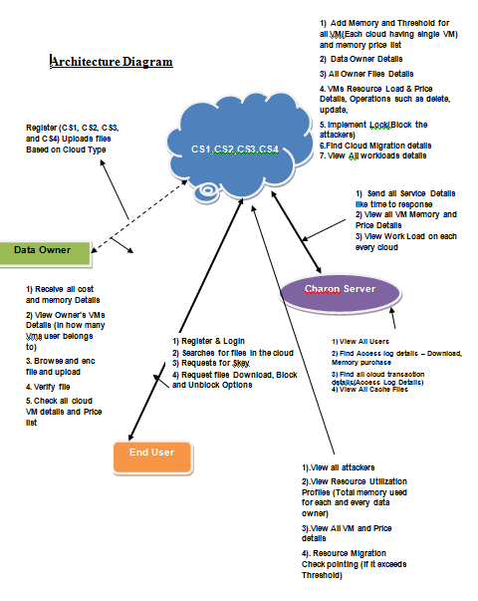
SYSTEM ARCHITECTURE:

Slide 9
SYSTEM REQUIREMENTS:
H/W System Configuration:
System - Core i3.
RAM - 500 GB .
Hard Disk - 2 GB
Software Requirements:
Operating System - Windows 7
Scripts - Java Scripts
Front End - HTML, Java, Jsp
Data Base - MySQL
Database Connectivity- JDBC

Slide 10
MODULES:
Authentication and Authorization Module: Ensures secure access to the system.
Data Storage Module: Manages the storage of big data across multiple cloud services.
Data Retrieval Module: Facilitates efficient retrieval of stored data.
File Sharing Module: Enables controlled sharing of files within the secure cloud ecosystem.
Encryption Module: Ensures data security through encryption mechanisms.
Audit and Logging Module: Tracks user activities for security and compliance.
Monitoring Module: Monitors system performance and resource utilization.
User Interface Module: Provides a user-friendly interface for seamless interaction.
These modules collectively contribute to the security, scalability, and usability of CHARON as a cloud of clouds system for storing and sharing big data

Slide 11
DATA FLOW DIAGRAM:
LEVEL 0:

Slide 12
LEVEL 1:

Slide 13
LEVEL 2:

Slide 14
FLOW CHART DIAGRAM:
CLOUD SERVER

Slide 15
FLOW CHART : DATA OWNER

Slide 16
FLOW CHART : REGISTRY ATHORITY

Slide 17
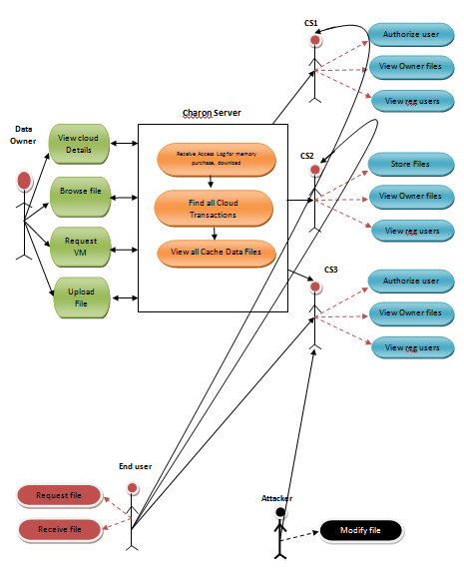
UML DIAGRAMS:
USECASE DIAGRAM

Slide 18
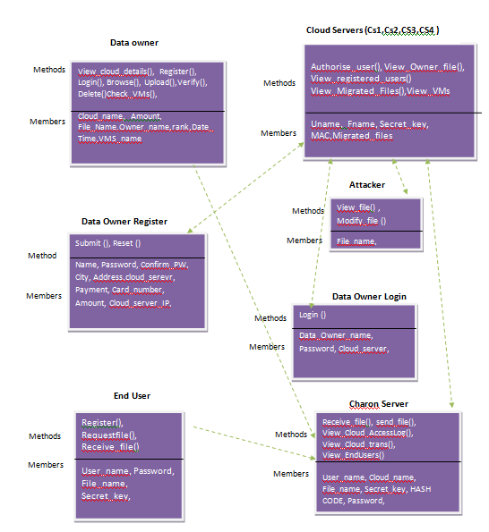
CLASS DIAGRAM

Slide 19
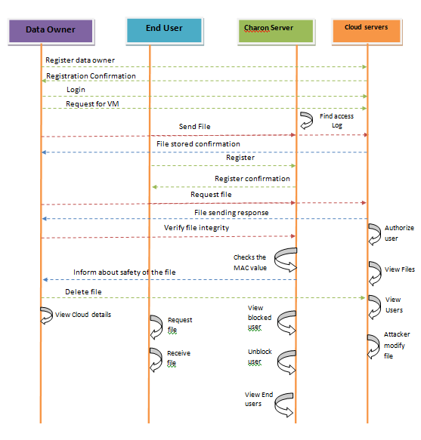
SEQUENCE DIAGRAM

Slide 20
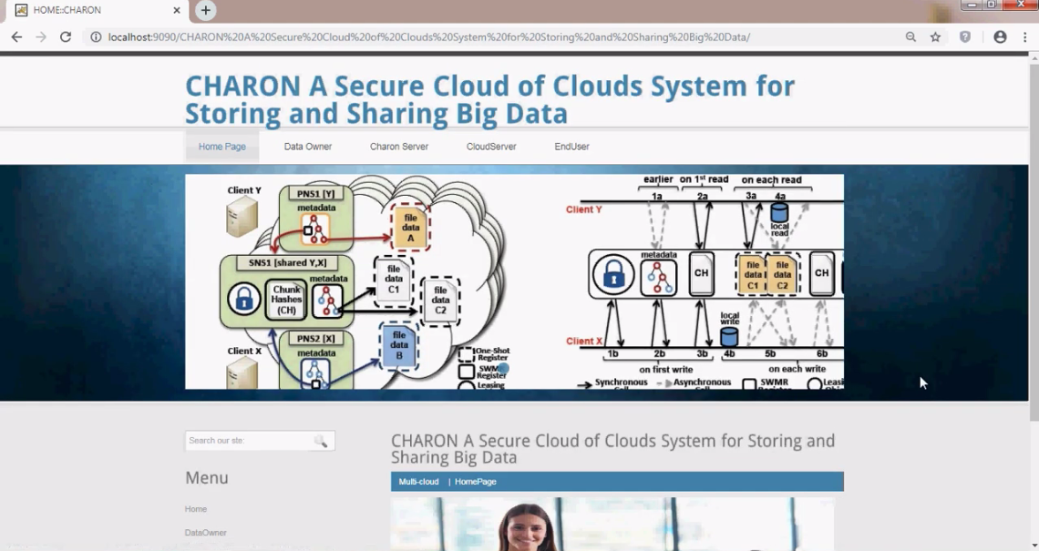
SAMPLE OUTPUT SCREENSHOTS:
Figure 1.1 CLOUD SERVER LOGIN

Slide 21
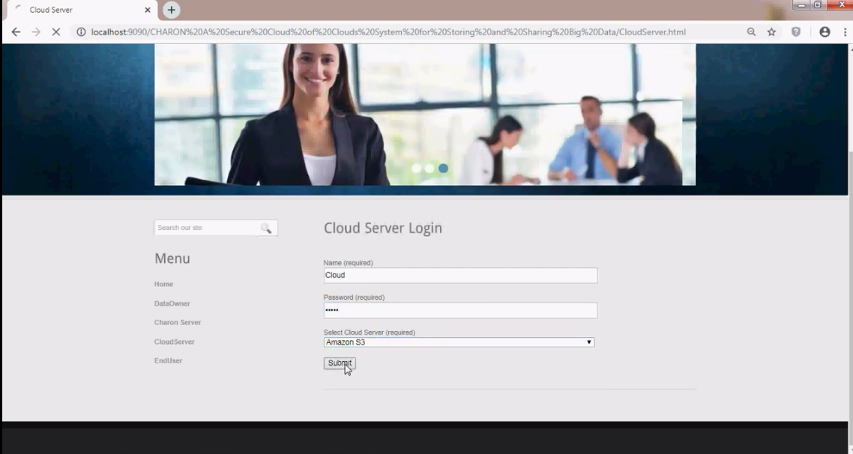
FIG 1.2 CLOUD SERVER LOGIN

Slide 22
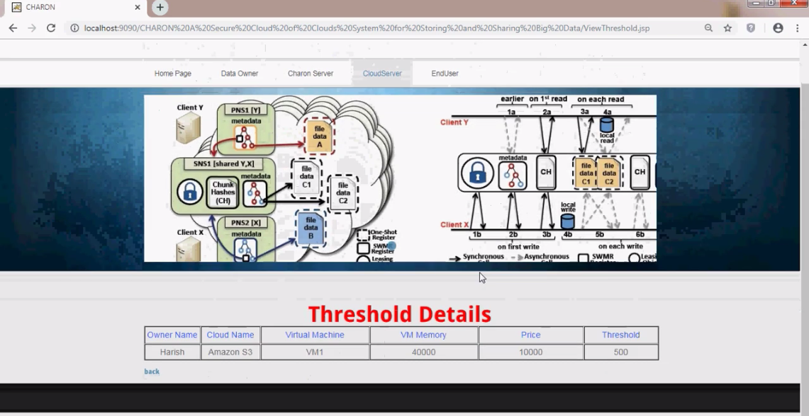
FIGURE 1.3 THRESHOLD DETAILS

Slide 23
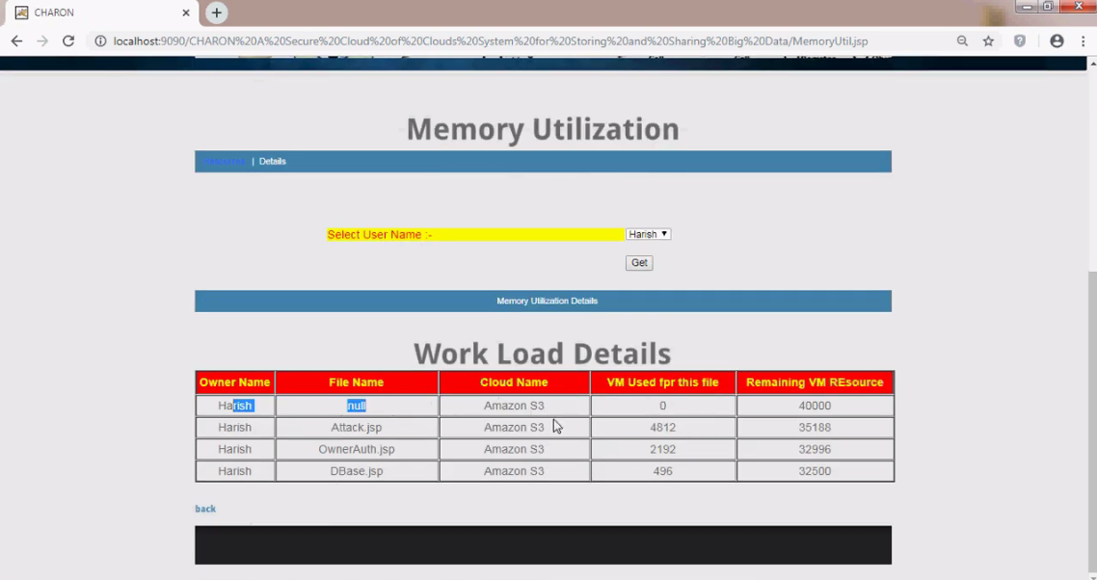
FIGURE 1.4 WORK LOAD DETAILS

Slide 24
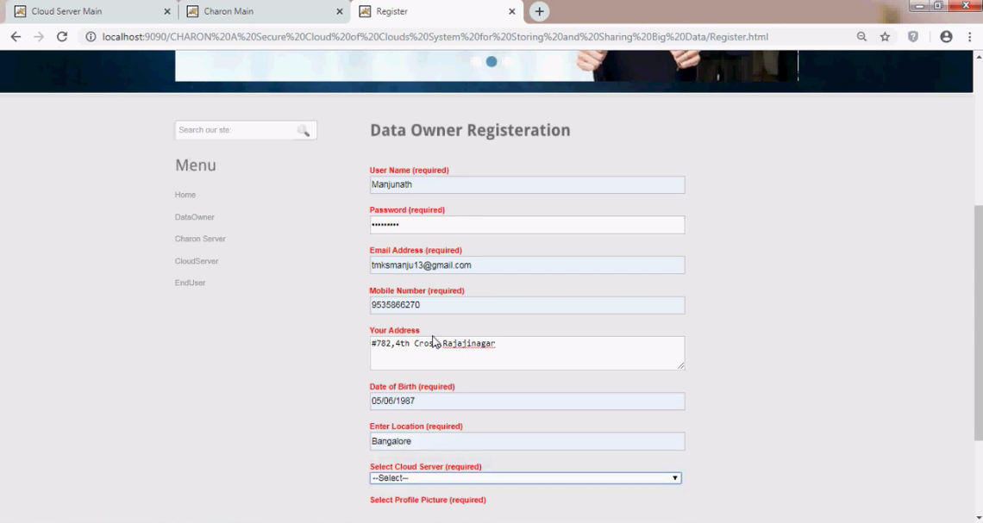
FIGURE 1.5 DATA OWNER REGISTERATION

Slide 25
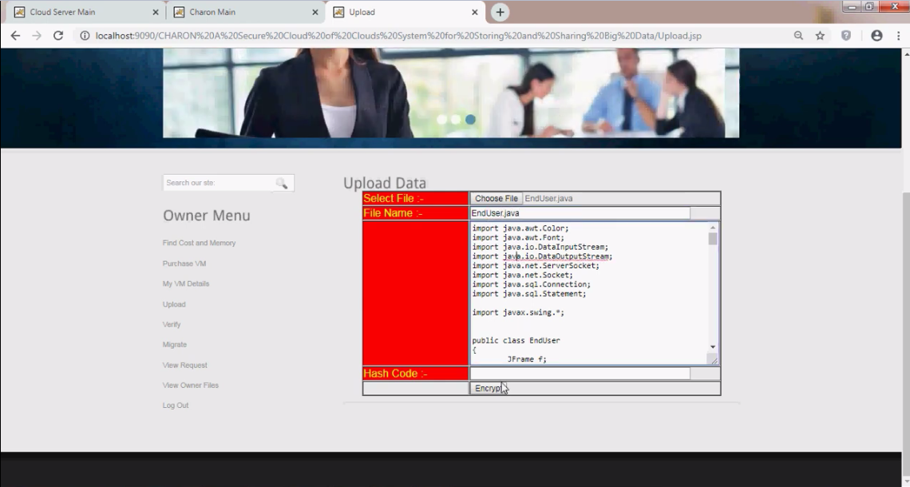
FIGURE 1.6 UPLOAD DATA

Slide 26
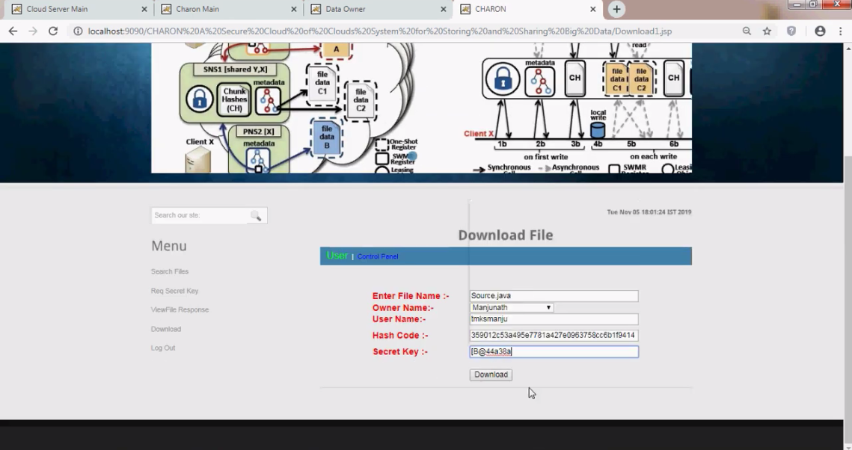
FIGURE 1.7 DOWNLOAD FILE

Slide 27
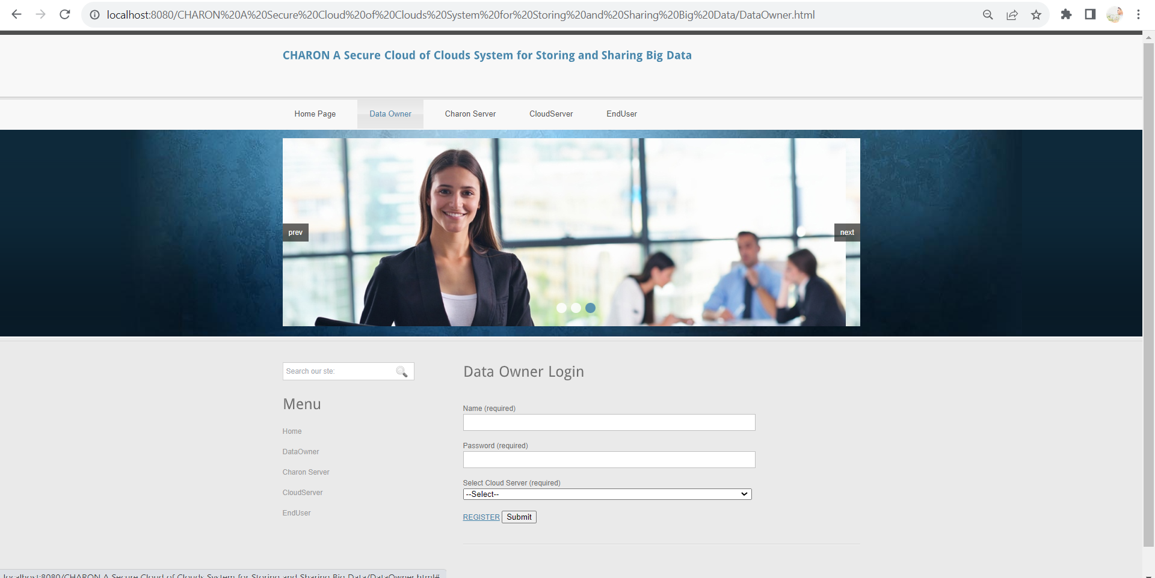
FIGURE 1.8 DATA OWNER

Slide 28
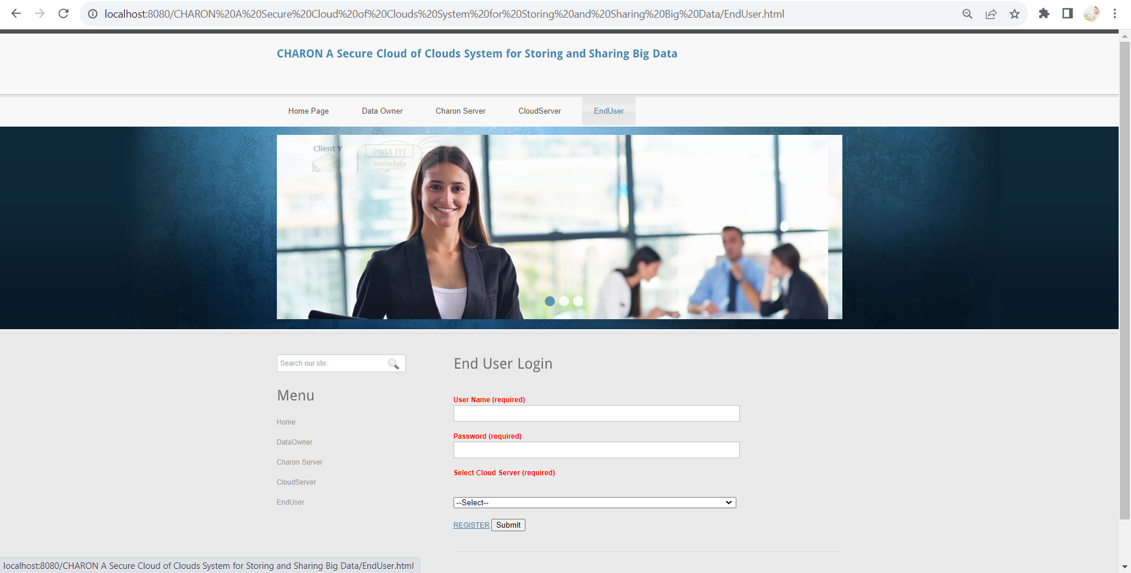
FIGURE 1.8 END USER LOGIN

Slide 29
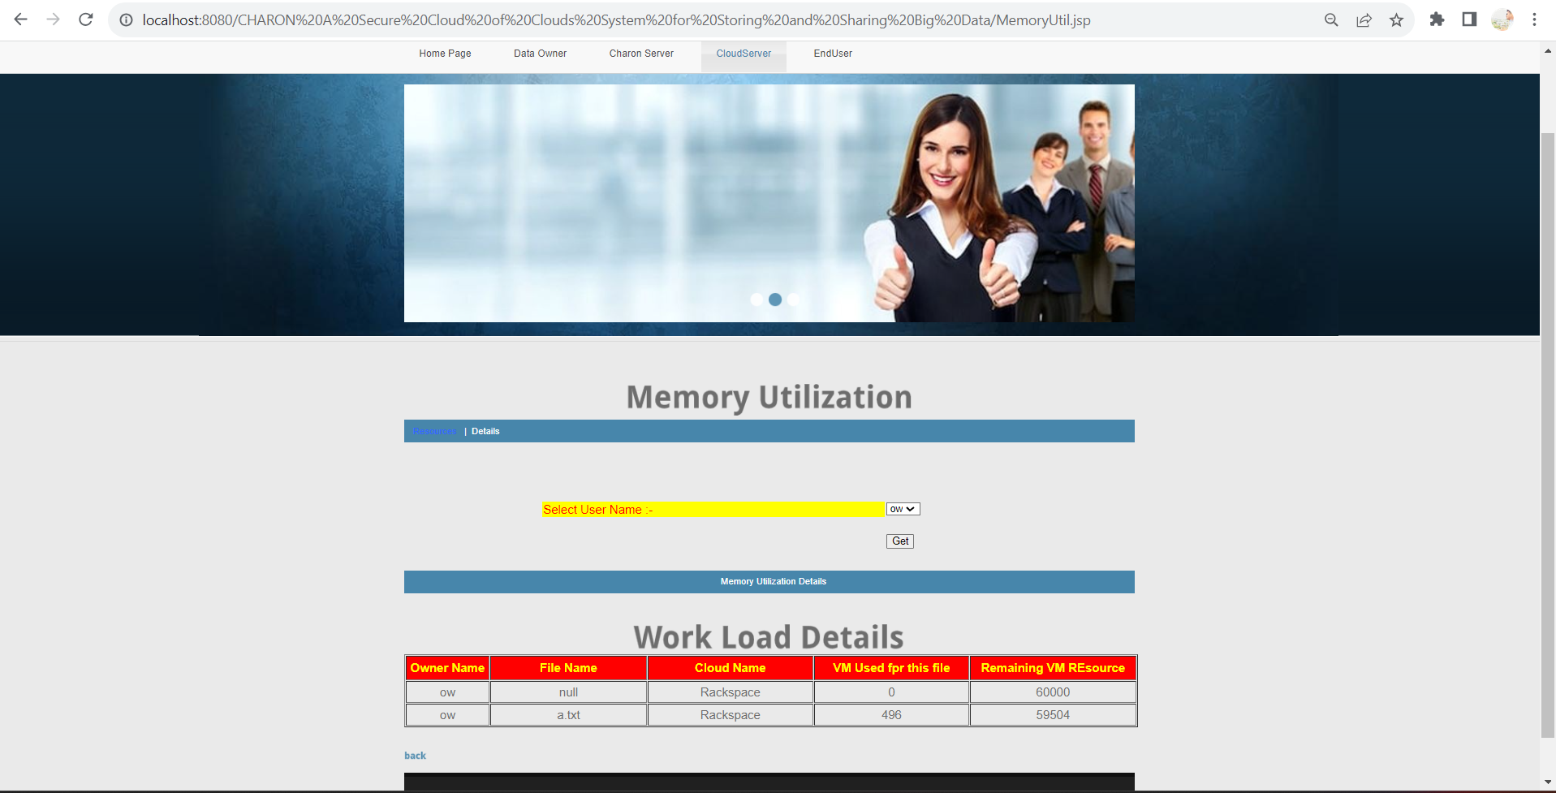
FIGURE 1.8 MEMORY UTILIZATION & DETAILS

Slide 30
CONCLUSION
CHARON is a cloud-backed file system for storing and sharing big data. Its design relies on two important principles: files metadata and data are stored in multiple clouds, without requiring trust on any of them individually, and the system is completely data centric. This design has led us to develop a novel Byzantineresilient leasing protocol to avoid write-write conflicts without any custom server. Our results show that this design is feasible and can be employed in real-world institutions that need to store and share large critical datasets in a controlled way.

Slide 31
THANK YOU

